Slide 1
Understanding the shared security model in azure
Vince Bryant – MS Partner Development Manager

Slide 2
Cloud adoption and trends
2015 > 2016 growth of 17.2% ($178B to $208B)
Highest growth from infrastructure as a service (IaaS) – 42% growth
Azure Compute consumption has more than doubled in the past year
New services continue to rollout:
Service Fabric
Azure Functions
Azure Analysis Services
DRIVERS:
IT Modernization
Savings
Innovation
Agility
INHIBITORS:
Security
Privacy
Integration challenges
Application incompatibilities
Management tools
Gartner Newsroom - Sep 16, 2016
http://www.gartner.com/newsroom/id/3443517
Notes:
Business agility – automated, rapid and frequent development to production
Elastic – grow up and down as needed
Lower costs – no capex, pay as you go, minimal setup

Slide 3
Cloud adoption and trends
2015 > 2016 growth of 17.2% ($178B to $208B)
Highest growth from infrastructure as a service (IaaS) – 42% growth
Azure Compute consumption has more than doubled in the past year
New services continue to rollout:
Service Fabric
Azure Functions
Azure Analysis Services
DRIVERS:
IT Modernization
Savings
Innovation
Agility
“The real security challenge is using public cloud services in a secure manner. More education is needed to help organizations overcome the hype associated with security concerns.“
Ed Anderson, research vice president at Gartner
September 2016
INHIBITORS:
Security
Privacy
Integration challenges
Application incompatibilities
Management tools
Gartner Newsroom - Sep 16, 2016
http://www.gartner.com/newsroom/id/3443517
Notes:
Business agility – automated, rapid and frequent development to production
Elastic – grow up and down as needed
Lower costs – no capex, pay as you go, minimal setup

Slide 4

Our 5 recommendations to secure your cloud applications
Know your responsibilities
Leverage native capabilities
Log everything
Put new processes in place
Leverage expertise

Slide 5
1. Know your responsibilities
Read Microsoft’s Shared Responsibility brief!
Learn the definitions
IaaS, PaaS, SaaS
Data classification
Understand their recommendations
Application protection is your responsibility
Shared Responsibility for Cloud Computing whitepaper - Microsoft, March 2016
Notes:
https://blogs.msdn.microsoft.com/azuresecurity/2016/04/18/what-does-shared-responsibility-in-the-cloud-mean/
There are Microsoft tools available, enabling and using them does not relieve you of your responsibilities. So with that…the model above shows a breakdown of responsibilities between you and Microsoft:
* For IaaS workloads running on Azure, Microsoft is responsible for securing the foundational services of the cloud, such as compute power, storage, database and networking services, and you are responsible for the configuration of those services and your data on the cloud. You are responsible for network traffic protection, and any incident reporting. The application security components of your site are also your responsibility.
For PaaS workloads, such as Azure AppServices or SQL, Microsoft is responsible for managing the security of the Host Infrastructure (VMs) and Network Controls (Virtual Networks, Endpoints, and Network Security Groups or Access Control Lists).
Microsoft’s Active Directory and Azure Active Directory can be used to manage the Access Management area, however this is something you have to implement and configure for your IaaS or PaaS deployments.
***
The first step to securing cloud workloads is understanding the shared responsibility model
Microsoft will secure most of the underlying infrastructure, including the physical access to the datacenters, the servers and hypervisors, and parts of the networking infrastructure…but the customer is responsible for the rest.

Slide 6








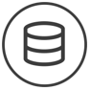







1. Know your responsibilities: Across the Stack
Web Application Firewall
Vulnerability Scanning
Secure Coding and Best Practices
Software and Virtual Patching
Configuration Management
Access Management (inc. Multi-factor Authentication)
Application level attack monitoring
Hypervisor Management
System Image Library
Root Access for Customers
Managed Patching (PaaS, not IaaS)
Security Monitoring
Log Analysis
Vulnerability Scanning
Access Management
Configuration Hardening
Patch Management
Logical Network Segmentation
Perimeter Security Services
External DDOS, spoofing, and scanning monitored
TLS/SSL Encryption
Network Security Configuration
Network Threat Detection
Security Monitoring
MICROSOFT
CUSTOMER
ALERT LOGIC

Slide 7
1. Know your responsibilities: Threats
Secure Coding and Best Practices
Software and Virtual Patching
Configuration Management
Access Management (inc. Multi-factor Authentication)
Application level attack monitoring
Web Application Firewall
Vulnerability Scanning
SQLi
Cross-site scripting
Web app exploits
Hypervisor Management
System Image Library
Root Access for Customers
Managed Patching (PaaS, not IaaS)
Security Monitoring
Log Analysis
Vulnerability Scanning
Middleware exploits
Brute force attacks
Recon
Access Management
Configuration Hardening
Patch Management
Logical Network Segmentation
Perimeter Security Services
External DDOS, spoofing, and scanning monitored
TLS/SSL Encryption
Network Security Configuration
Network Threat Detection
Security Monitoring
Web shells
Command & Control
Service Misconfiguration
Suspicious IAM Activity
MICROSOFT
CUSTOMER
ALERT LOGIC

Slide 8
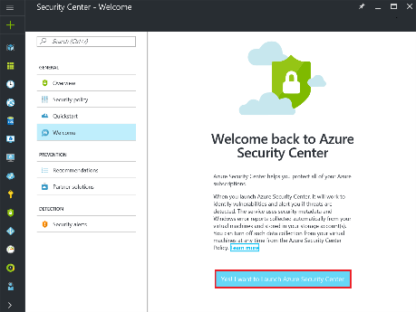
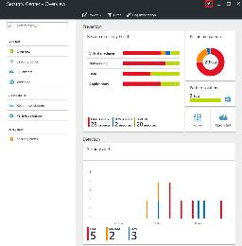
1. Know your responsibilities: Microsoft Security Tools
Azure Security Center (ASC) and Operations Management and Security (OMS)
Collect security related info for your teams to act on
You are still responsible for configuration and management
Azure Active Directory
Identity and Access Management for Azure (and other applications)
MS does provide best practices recommendations for RBAC (least privilege, MFA, etc)
Apply more granular policies (i.e. by Resource Group)
Notes:
https://docs.microsoft.com/en-us/azure/active-directory/role-based-access-control-configure

Slide 9
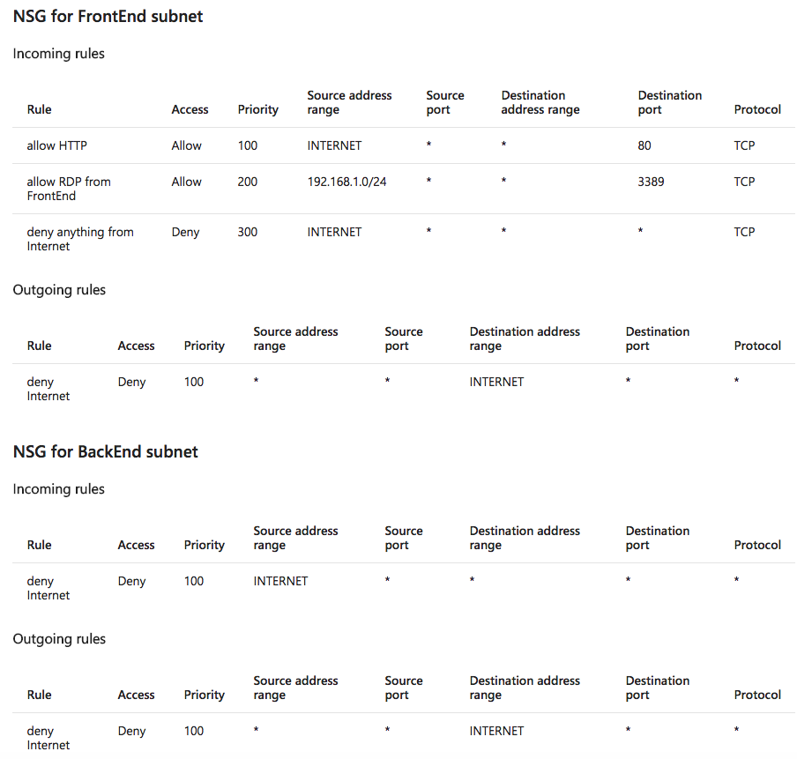
2. Leverage platform capabilities: Network Access
Network controls and configurations
Azure Virtual Network
Hybrid
VNET peering
Network Security Groups
NIC or subnet level
Check the defaults
Benefits
Granular
Scalable and work w/ autoscaling
Reusable policies for ephemeral workloads or continuous deployment pipelines
Notes:
https://docs.microsoft.com/en-us/azure/virtual-network/virtual-network-nsg-manage-log

Slide 10
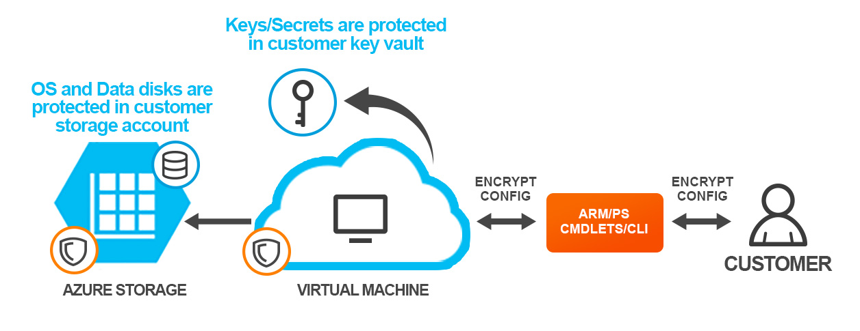
2. Leverage platform capabilities: Encryption
Notes:
https://docs.microsoft.com/en-us/azure/security/azure-security-disk-encryption
Protect data and OS configuration on VMs at rest

Slide 11
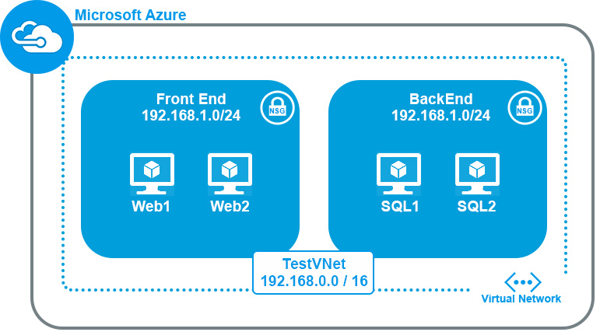
2. Leverage platform capabilities: Automation
Template driven automation simplifies the deployment process for developers
Reuse templates to keep ops velocity without comprising security
Define a consistent tagging and naming strategy for resources
NSG configurations
Logging
Identify and remediate vulnerabilities in your images
Patch your images, not your VMs
Maintain a list of trusted images, prevent your users from launching non-trusted images
Notes:
https://docs.microsoft.com/en-us/azure/azure-resource-manager/resource-manager-template-walkthrough

Slide 12

3. Log everything, always!
Logging
OS + Application logs
Azure Activity logs
Azure services logs
Considerations
Egress
Multiple copies
Encryption / Retention / Access

Slide 13
3. Log everything: Azure Activity Log
Activity logs track every activity in your subscription
Lock down access
Audit NSG configurations
Access management
Notes:
https://docs.microsoft.com/en-us/azure/azure-resource-manager/resource-group-audit

Slide 14
4. Put new processes in place
Scan often
Review access logs, reduce access scope
Review roles and responsibilities across functional groups
Software patching

Slide 15
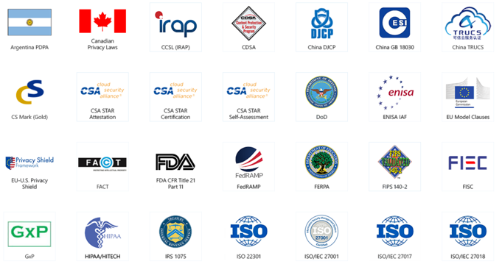
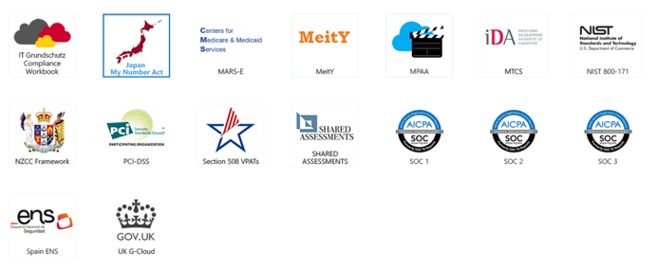
5. Leverage expertise: Compliance
Attestations for Microsoft Azure
https://www.microsoft.com/en-us/TrustCenter/Compliance?service=Azure#Icons

Slide 16
5. Leverage expertise: Cloud
Organizations want …
… but traditional security products are ...
Security solutions must now…
Customer reach
Reach any potential customer, either on the web or mobile, around the world
Velocity
Fast, automated deployments
Scale
Pay for what I use, and scale up and down with demand
Primarily focused on OS and Network level protection, not web applications
Slow and complex to deploy
Were designed to maintain a perimeter, and can create chokepoints for scalable workloads
Protect web applications and other elements in the stack
Deploy in minutes through APIs or DevOps toolsets
Scale with workloads
Deploy out of band
Tear down when ephemeral workloads are finished

Slide 17
5. Leverage expertise: Threats
Web app attacks are now the #1 source of data breaches
But less than 5% of data center security budgets are spent on app security
Web App Attacks
UP 500% SINCE 2014
$23 to $1
Source: Gartner
10%
20%
30%
40%
Percentage of Breaches
Source: Verizon
Notes:
Yet, businesses today are spending less than 5% of their security budgets protecting these valuable assets. (Veracode / Gartner)
But attacks on web applications accounted for over 40 percent of incidents resulting in a data breach, and were the single-biggest source of data loss. –( Verizon 2016 ) and These stats are reflected in Alert Logic, where application attacks comprise the Top 5 attacks seen in the SOC – totaling 53.8% of all attacks.

Slide 18
ALERT LOGIC overview

Slide 19
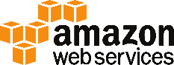
We protect cloud workloads & web applications
FULLY-MANAGED SECURITY, DELIVERED AS A SERVICE
Full-stack security
Integrated analytics & experts
Built for cloud
Cost-effective outcomes
ASSESS
DETECT
BLOCK
COMPLY
Hosting
Data Center

Slide 20


Cloud Defender delivers full stack security, experts included
Cloud Defender
Active Watch
Security Analytics
Experts Analysis
Web Apps
Web App Attacks
OWASP Top 10
Signatures & Rules
Anomaly Detection
Machine Learning
Threat Intelligence
Security Research
Data Science
Security Content
Security Operations Center
Server-side Apps
Web Security Manager
App Frameworks
Dev Platforms
Log Manager
Platform / Library Attacks
Databases
Server OS
Threat Manager
System / Network Attacks
Hypervisor
Hardware
Your App Stack
SaaS Technology
Managed Security

Slide 21
3-Tier applications using VMs only
VNET
Alert Logic
Web Tier
VM ScaleSets
Application Tier
VM ScaleSets
Database Tier
SQL VM AvailabilitySets
Web Traffic
Customer A
AutoScale
AutoScale
RESOURCE GROUP
VM
Threat Manager
Appliance
Web Tier
VM ScaleSets
Application Tier
VM ScaleSets
Database Tier
SQL VM AvailabilitySets
Web Traffic
Customer B
AutoScale
AutoScale
RESOURCE GROUP
VNET

Slide 22





How to find out more
Learn more about our solutions or request a demo: www.alertlogic.com/azure
Review MS Azure Security Best Practices:
https://docs.microsoft.com/en-us/azure/security/security-get-started-overview
https://docs.microsoft.com/en-us/azure/security/security-best-practices-and-patterns
www.alertlogic.com

Slide 23
Additional information

Slide 24
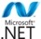
New capabilities focused on Web Attack Detection
Attacks
Web App Attacks
OWASP top 10
1
Over 150 new web attack incidents
2
Improved OWASP Top 10 Coverage
powered by Anomaly Detection
Platform / library attacks
App / System misconfig attacks
3
Advanced SQL Injection Detection powered by Machine Learning
Over 250 breaches detected in 2016

Slide 25
Alert Logic solutions are easy to deploy
Use a combination of host based agents and appliances to collect network and application traffic
Agents also collect logs from the VM
Azure Activity Logs are collected via the Azure Monitor API
Azure SQL or App Services Logs are collected from Azure storage accounts
Appliances can be used to do internal scanning, or we can do external and PCI scanning from our cloud

Slide 26
HOW IT WORKS: Alert Logic Threat Manager for 3 Tier Application Stack + Azure SQL
VNET
Azure Storage
Table SQL Logs
Alert Logic
VM
Threat Manager
Appliance
Application
Gateway
Web Tier
VM ScaleSets
Application Tier
VM ScaleSets
Database
Tier
Web Traffic
AutoScale
AutoScale
Azure SQL
RESOURCE GROUP

Slide 27
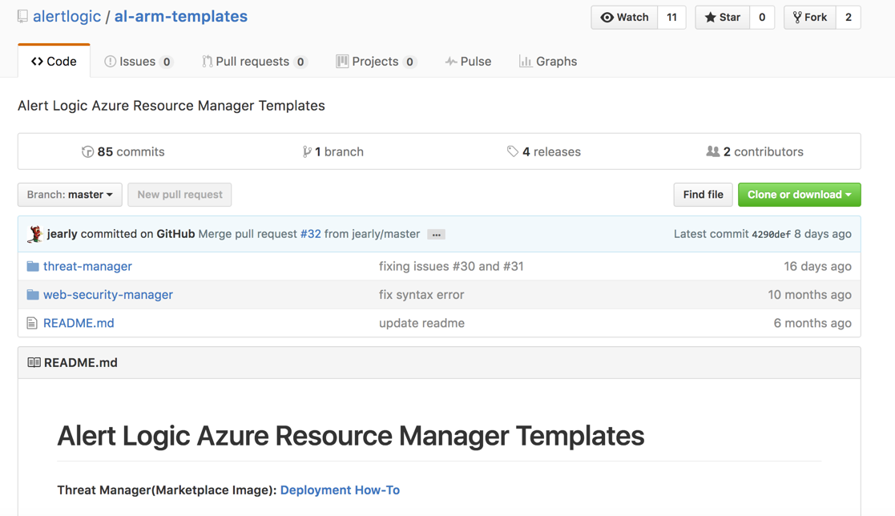
ARM Template automate appliance deployments
https://github.com/alertlogic/al-arm-templates

Slide 28
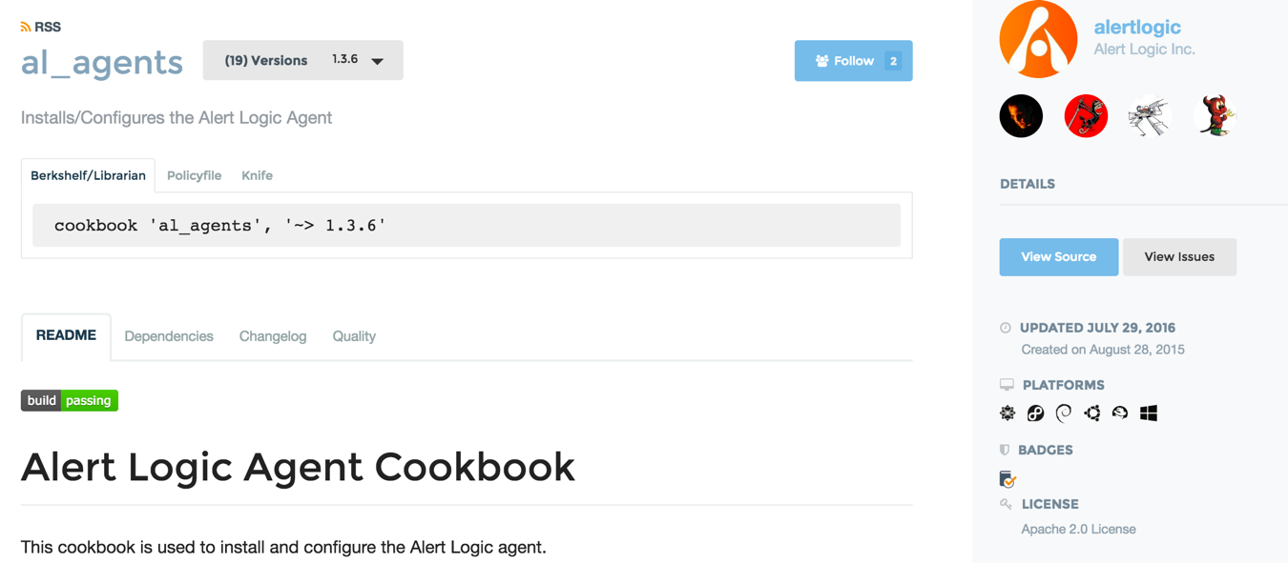
Agents can be baked into VM images, or automatically installed using DevOps toolsets
https://supermarket.chef.io/cookbooks/al_agents

Slide 29
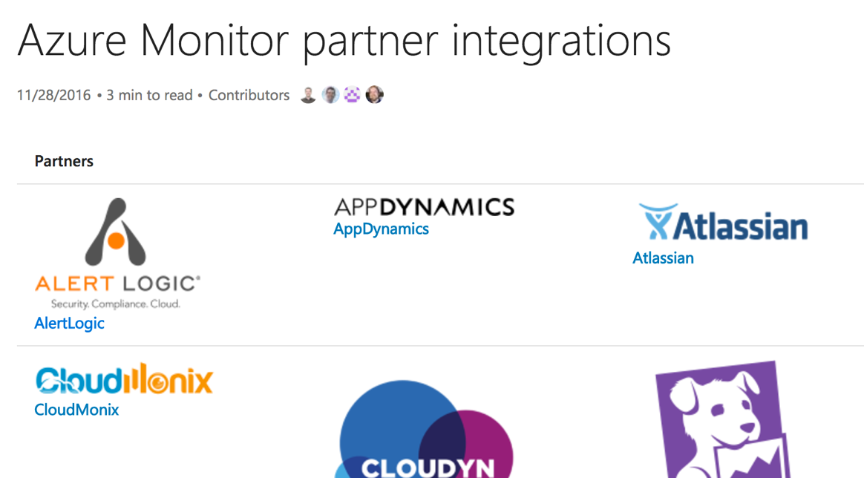
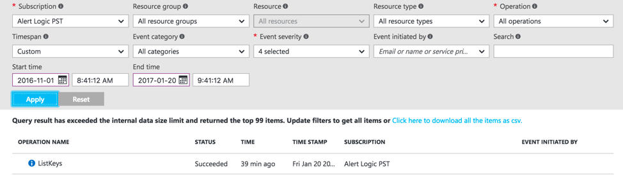
Azure Activity Logs identify IOCs at the subscription level
These logs can show changes to NSG configurations or privilege escalation
https://docs.microsoft.com/en-us/azure/monitoring-and-diagnostics/monitoring-partners

Slide 30

We scan the entire stack for vulnerabilities and config errors
Web Apps
Server-side Apps
Our coverage is prioritized by applications and workloads running in the cloud
App Frameworks
Dev Platforms
Databases
Server OS
Hypervisor

Slide 31







Alert Logic is security built for the cloud
Prevent, detect and stop threats across your full app & infra stack
Add expert protection without adding staff or building SOC
Eliminate chokepoints in app production with security built for cloud
Expand capabilities quickly with modular services
Focus on actionable detail with expert verification and prioritization
Affordable advanced protection from 13 cents / hour / host

Slide 32
Incident identification and notification
ATTACK
Alert Logic
SOC
Azure
CONSOLE
Incident notification
AWS
CONSOLE
Customer / Partner
SecOps Team
ALERT LOGIC
CLOUD
On-prem
We can either work with your customer directly, or your teams if you are managing the environment on behalf of the customer

Slide 33
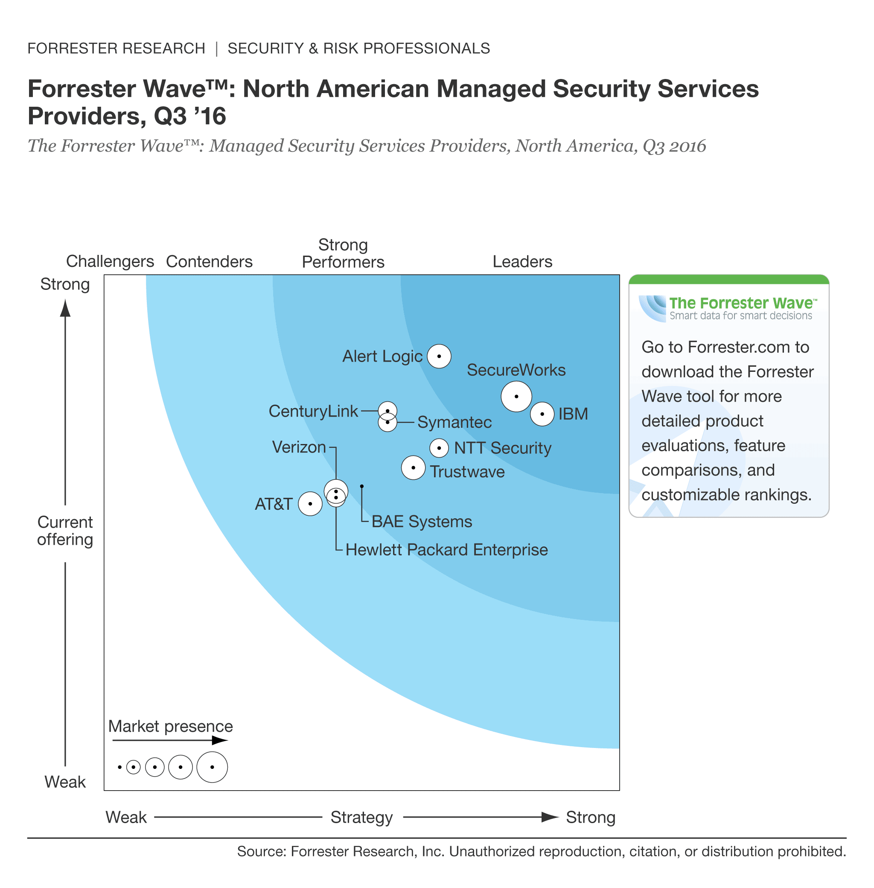
Alert Logic – a Leader in Forrester’s 2016 NA MSSP WAVETM
“Alert Logic has a head start in the cloud, and it shows.
Alert Logic is an excellent fit for clients looking to secure their current or planned cloud migrations, clients requiring a provider than can span seamlessly between hybrid architectures, and those that demand strong API capabilities for integrations.”
- Forrester WAVETM Report

Slide 34
Addressing Customers with Compliance Requirements
Alert Logic Solution | PCI DSS | SOX | HIPAA & HITECH
Alert Logic Web Security Manager™ | 6.5.d Have processes in place to protect applications from common vulnerabilities such as injection flaws, buffer overflows and others 6.6 Address new threats and vulnerabilities on an ongoing basis by installing a web application firewall in front of public-facing web applications. | DS 5.10 Network Security AI 3.2 Infrastructure resource protection and availability | 164.308(a)(1) Security Management Process 164.308(a)(6) Security Incident Procedures
Alert Logic Log Manager™ | 10.2 Automated audit trails 10.3 Capture audit trails 10.5 Secure logs 10.6 Review logs at least daily 10.7 Maintain logs online for three months 10.7 Retain audit trail for at least one year | DS 5.5 Security Testing, Surveillance and Monitoring | 164.308 (a)(1)(ii)(D) Information System Activity Review 164.308 (a)(6)(i) Login Monitoring 164.312 (b) Audit Controls
Alert Logic Threat Manager™ | 5.1.1 Monitor zero day attacks not covered by anti-virus 6.2 Identify newly discovered security vulnerabilities 11.2 Perform network vulnerability scans quarterly by an ASV or after any significant network change 11.4 Maintain IDS/IPS to monitor and alert personnel; keep engines up to date | DS5.9 Malicious Software Prevention, Detection and Correction DS 5.6 Security Incident Definition DS 5.10 Network Security | 164.308 (a)(1)(ii)(A) Risk Analysis 164.308 (a)(1)(ii)(B) Risk Management 164.308 (a)(5)(ii)(B) Protection from Malicious Software 164.308 (a)(6)(iii) Response & Reporting
Alert Logic Security Operations Center providing Monitoring, Protection, and Reporting
Notes:
I’ve mentioned many times that some of the best clients are subject to regulations, especially PCI.
The reason I zero in on PCIs, it’s very prescriptive in what it requires. It requires at the application layer that they put in a web application firewall or they do code reviews. It’s much easier to put in a protection because people are always editing their application. From a logging perspective, it’s clear that you’ve got to collect the logs, you must keep them available online for 90 days, you must store them for 12 months and you’ve got to review them on a daily basis.
Our services check all those boxes and more.
At the network layer, you’ve got to provide scans and you need to do intrusion detection, intrusion prevention and you got to keep it up to date and then you’ve got to review the incidences that come up on a 24 hour basis.
We check all those boxes. Customers that have HIPAA - patient records - absolutely are interested. Most of those firms do not have the internal resources or the big capital budgets to be able to afford the products, let alone the analytics and content or the teams necessary to keep it up to date and deliver the outcome that’s required.
Then publicly traded companies have to protect their core infrastructure, and Alert Logic handles that beautifully.
So more than half of our customers are buying us because they’ve got compliance mandates forcing them to do something.
When you hear the customer takes credit cards or you know they have patient records, or they’re publicly held, then you should raise Alert Logic in the conversation.

